Slide 1
CS347 Final Project Review
Jonathan Chu
Austin Siu

Slide 2
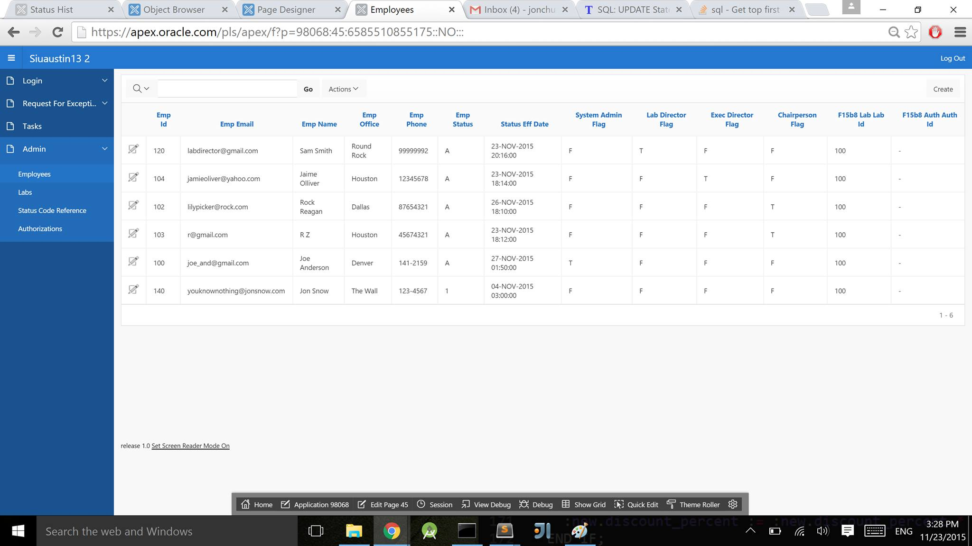
ARL RFE App

Slide 3
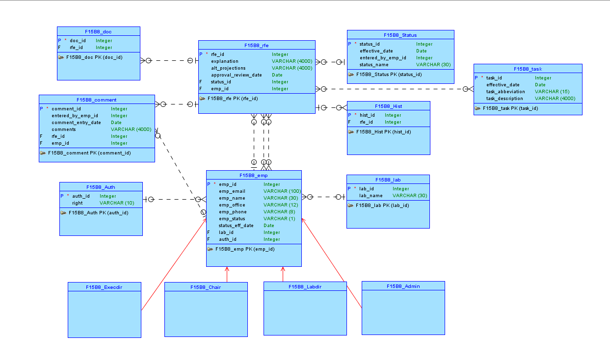
ARL RFE: Conceptual Model

Slide 4
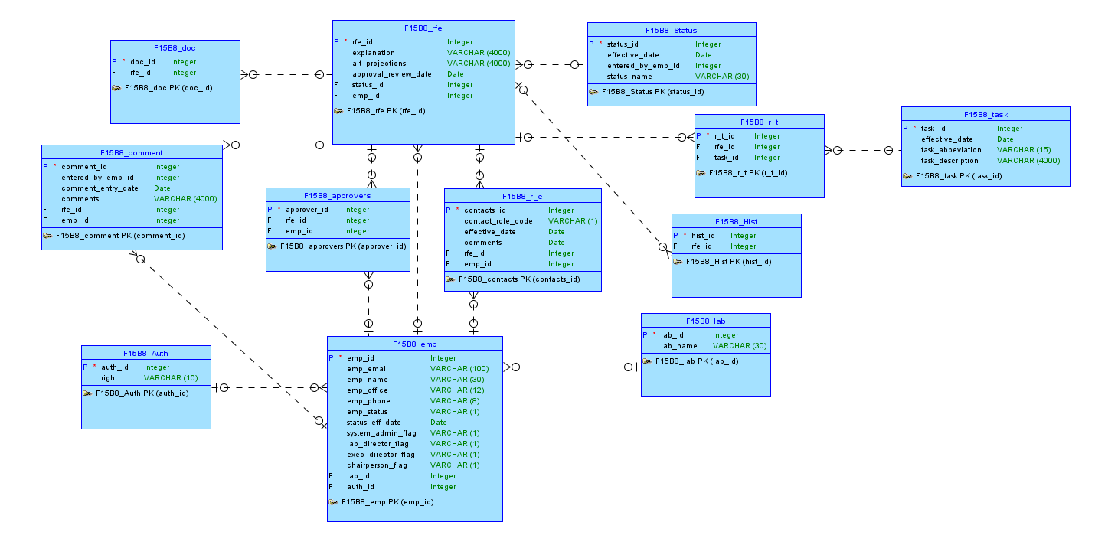
ARL RFE: Logical Model

Slide 5
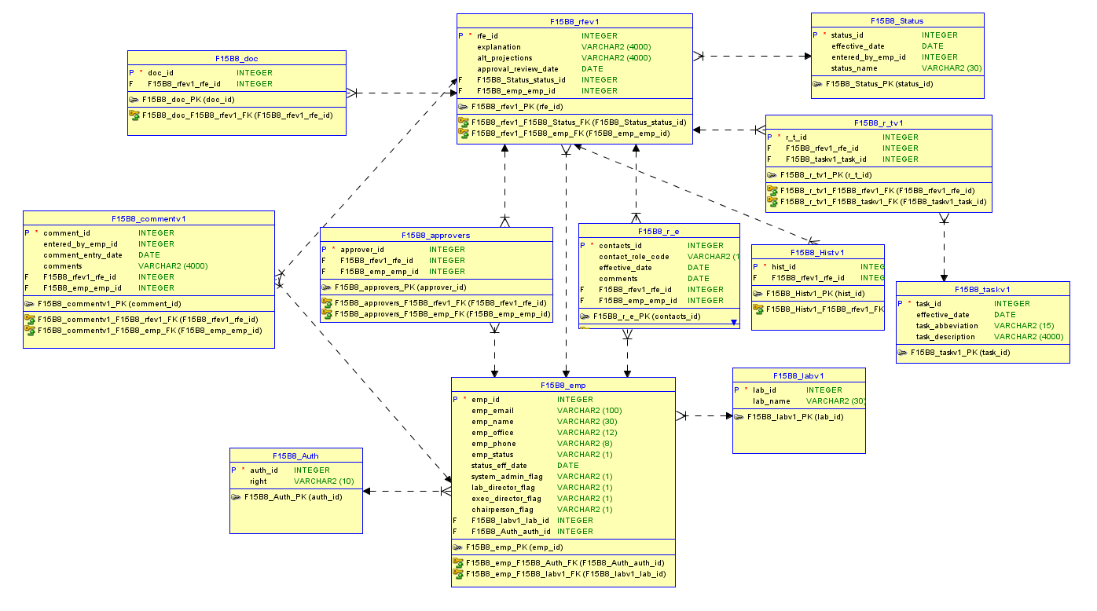
ARL RFE: Relational Model

Slide 6
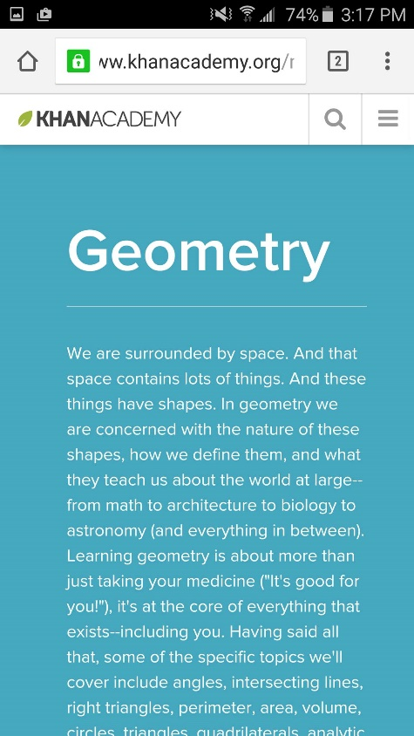
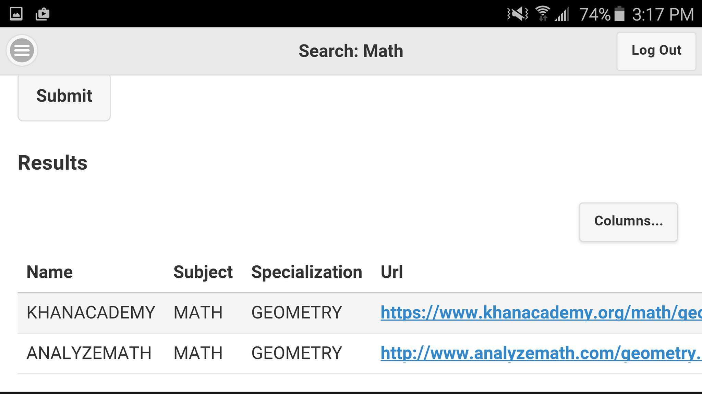
Study Resource Mobile App
A browser-based application that runs inside the browser on a mobile device
Record the Name, Subject, Specialization and URL of favorite study websites

Slide 7
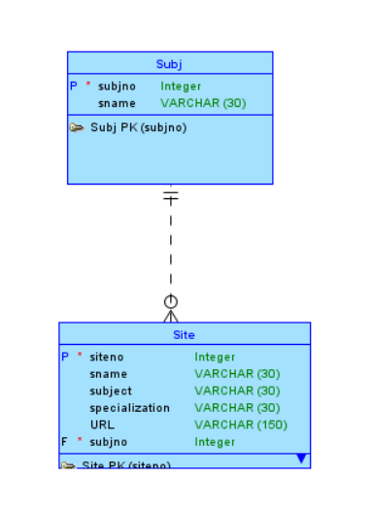
SRMA: Conceptual Model

Slide 8
GitHub
https://github.com/AustinSiu/F15B8_Project.git

Slide 9
Questions

